Slide 1
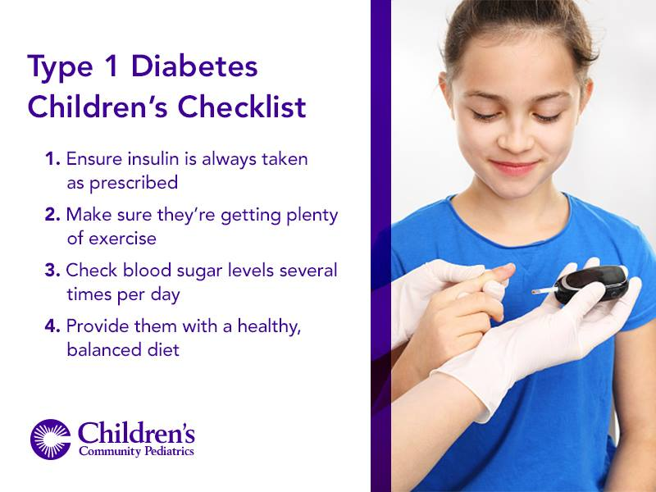

DIABETES TYPES THE GOAL IS GET 100 % FOR Diabetes Expectation Class
SADAIA TUWAIQ BOOTCAMP T5 4 WEEKS

Slide 2
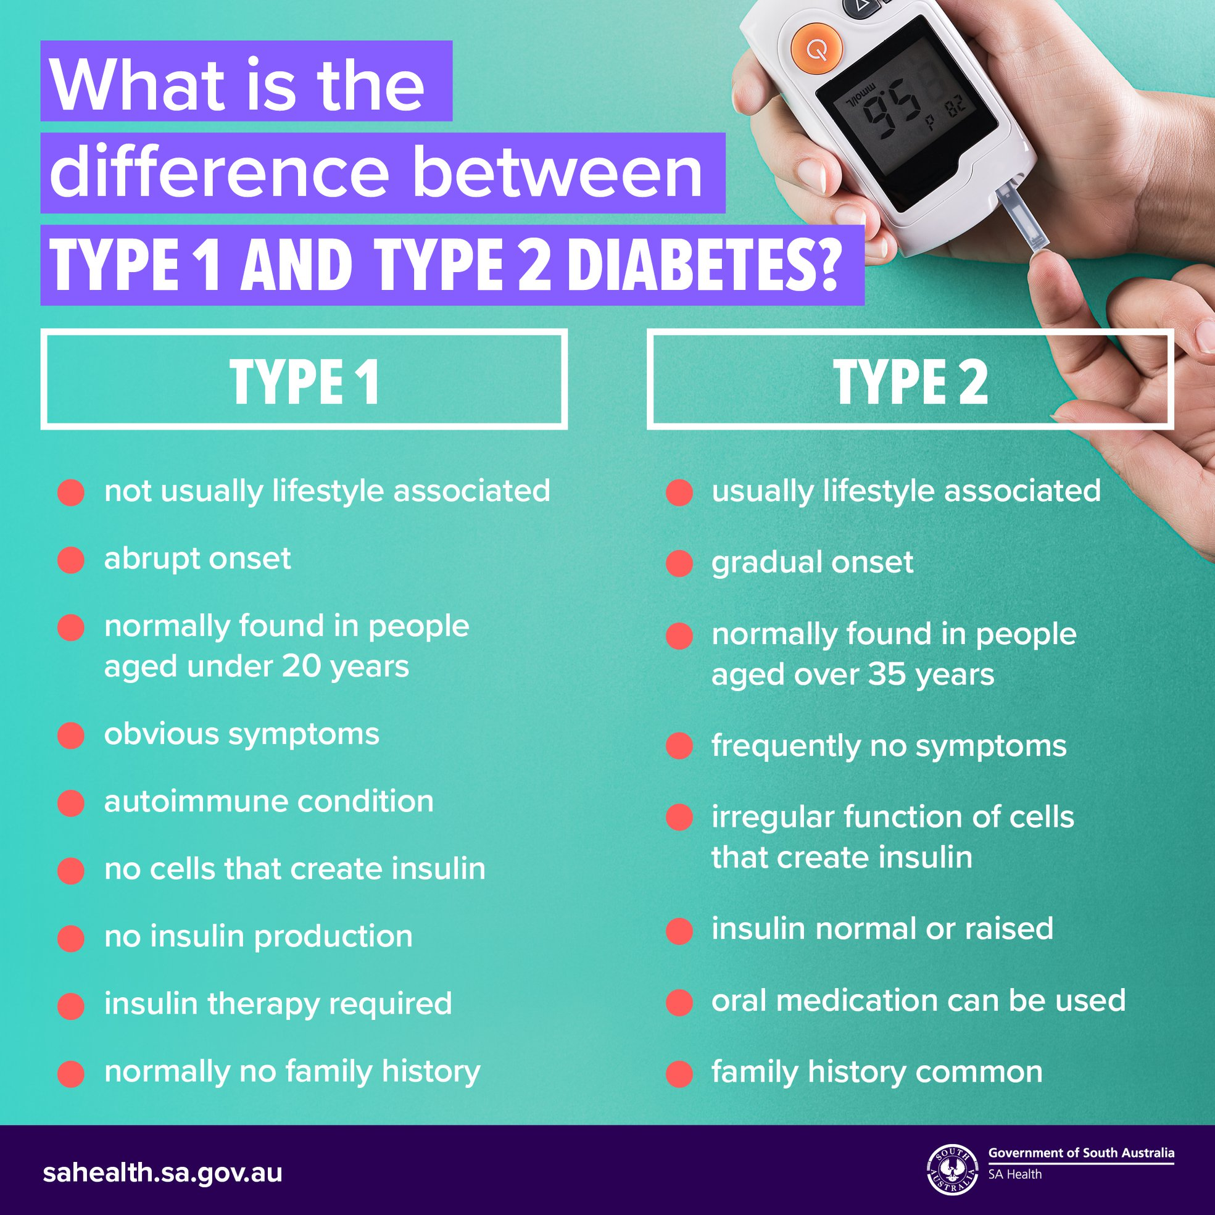
SADAIA TUWAIQ BOOTCAMP T5 4 WEEKS

Slide 3
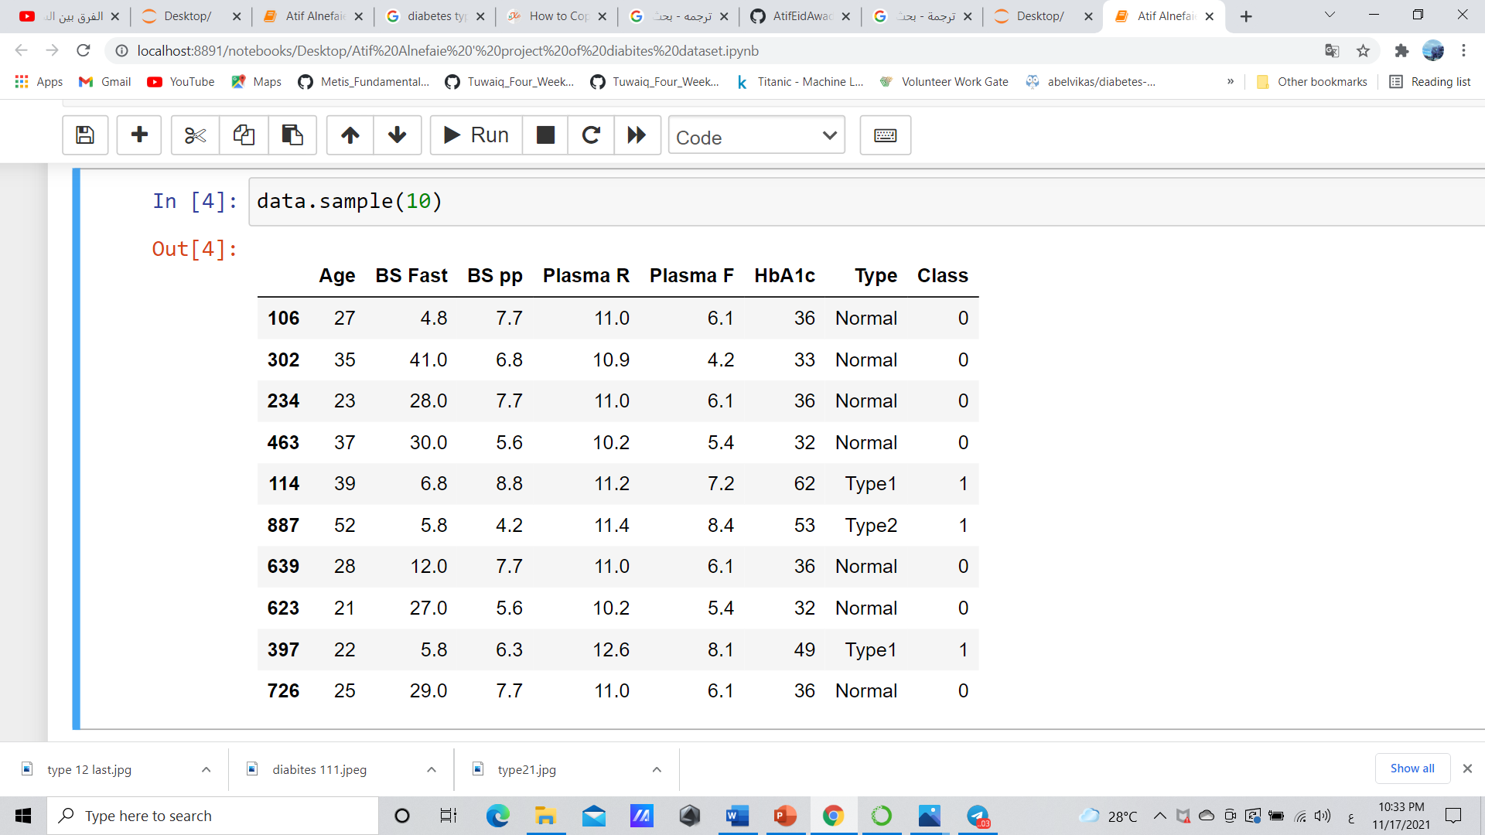
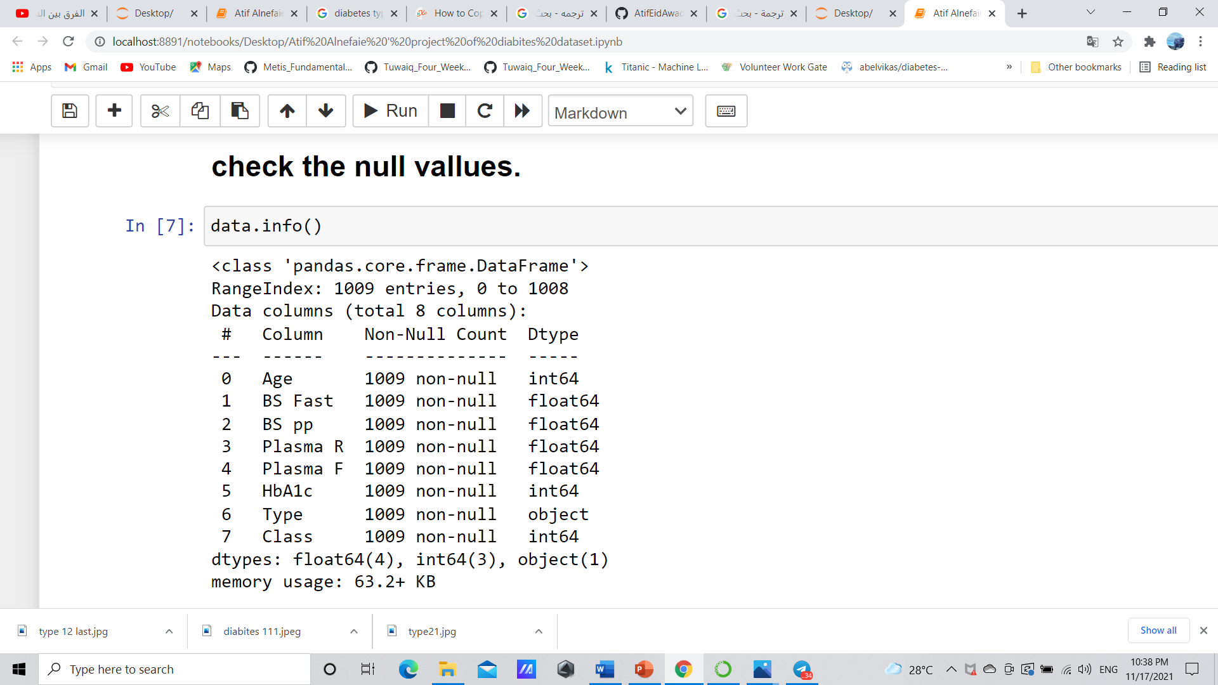
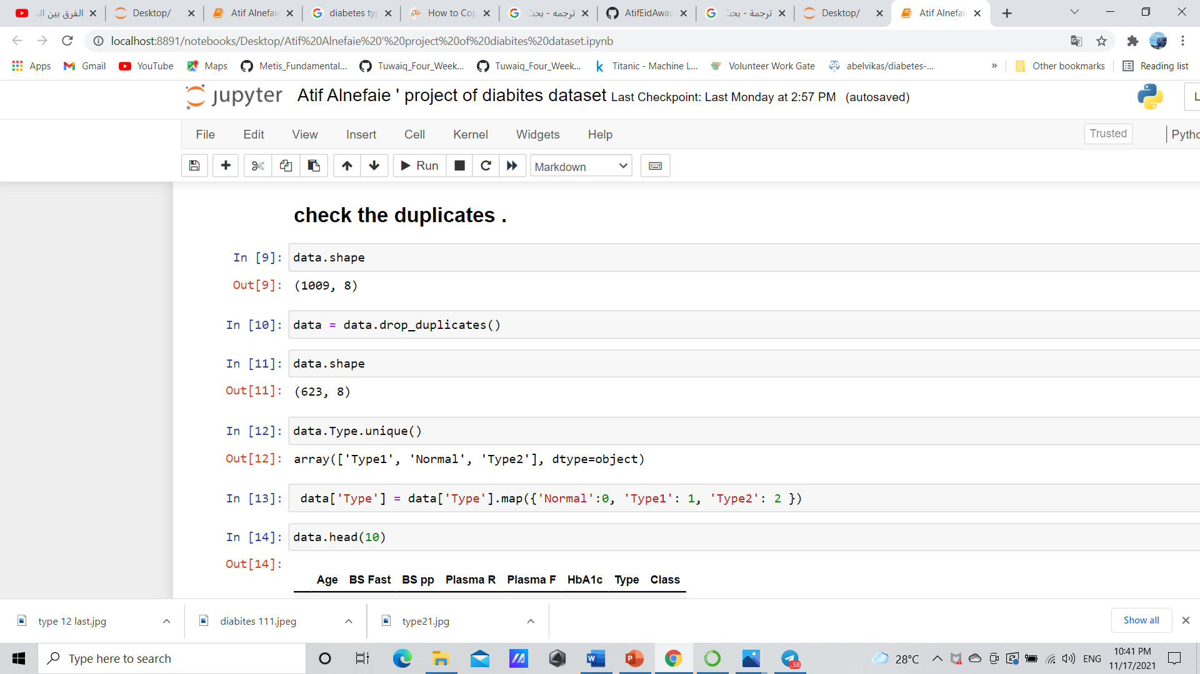
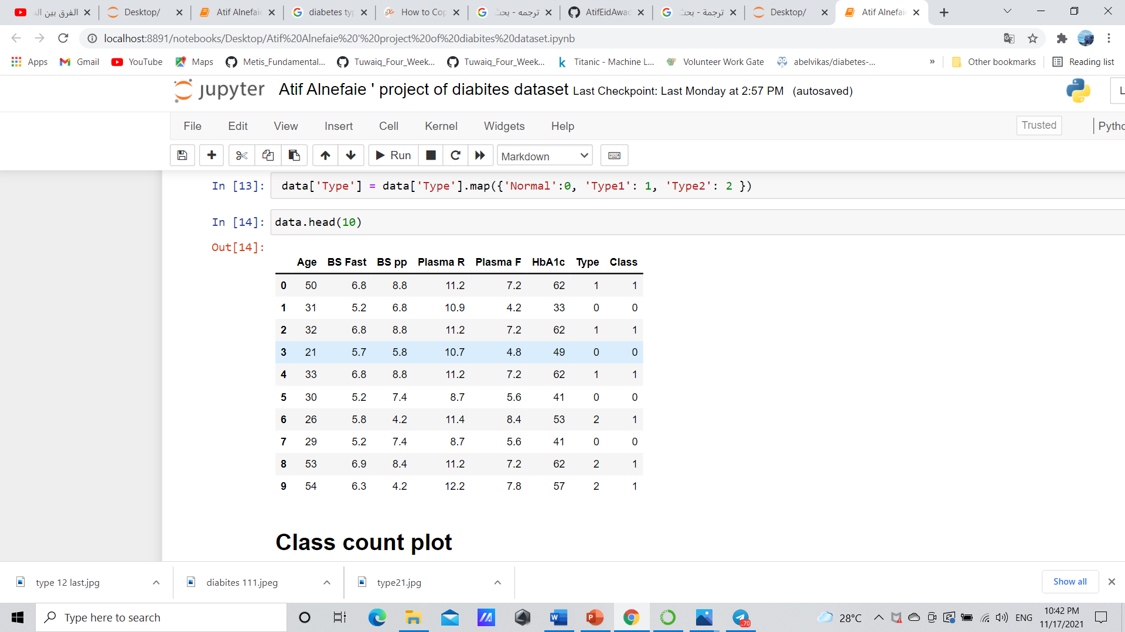
Exploratory Data Analysis EDA We used machine learning as an essential element in data science to make all data numeric
SADAIA TUWAIQ BOOTCAMP T5 4 WEEKS

Slide 4
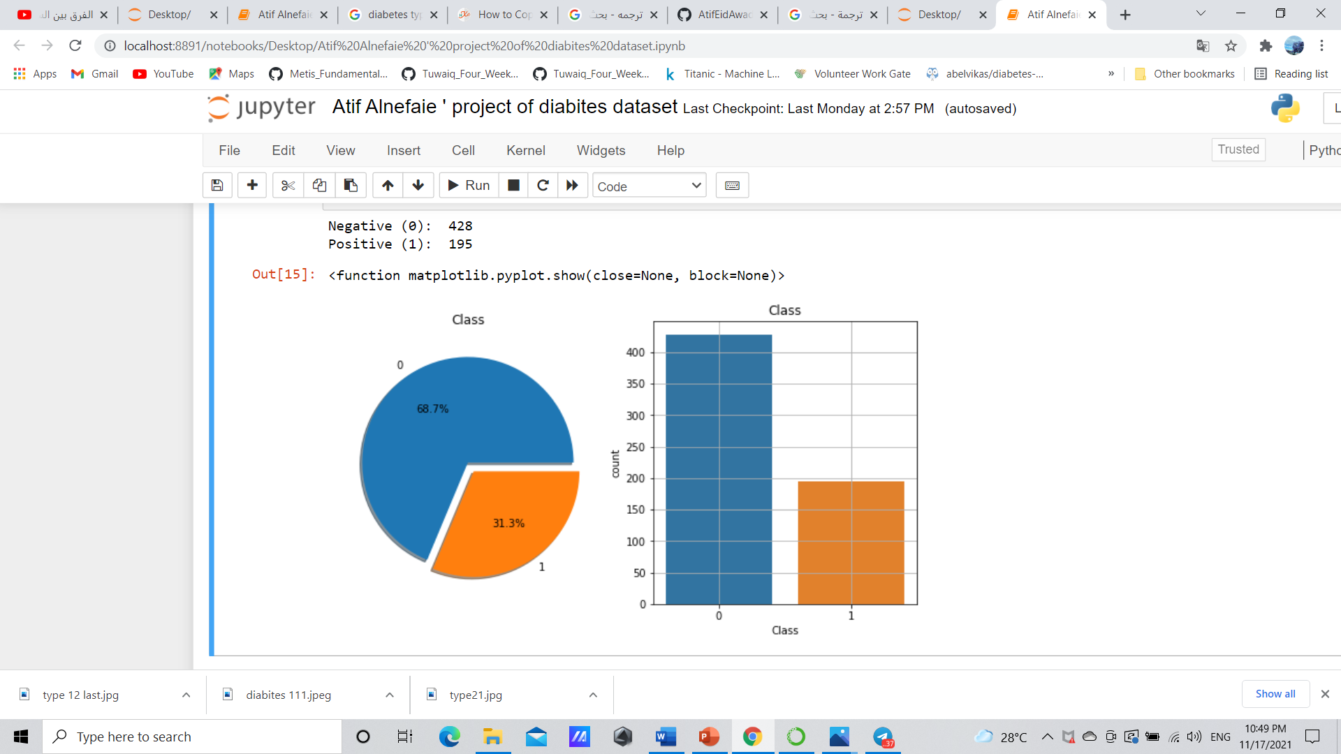
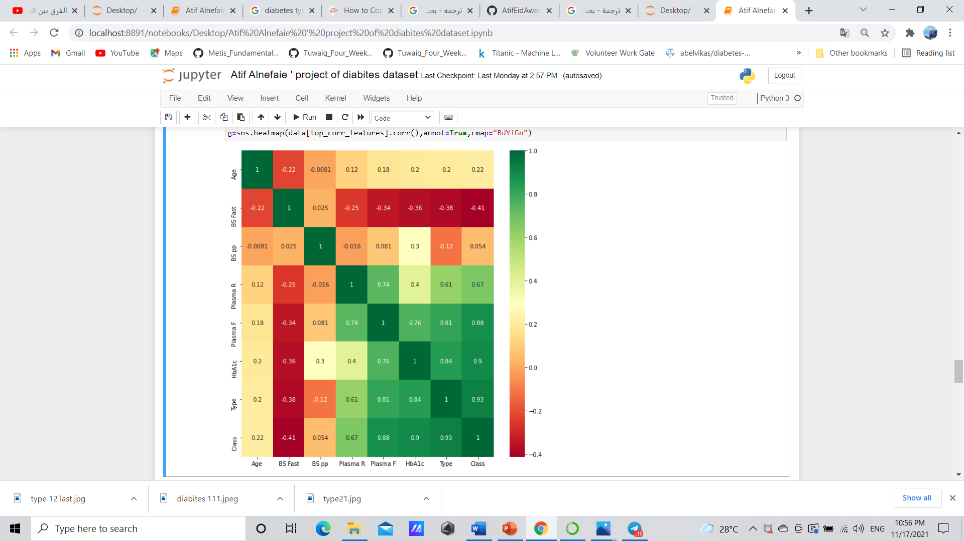
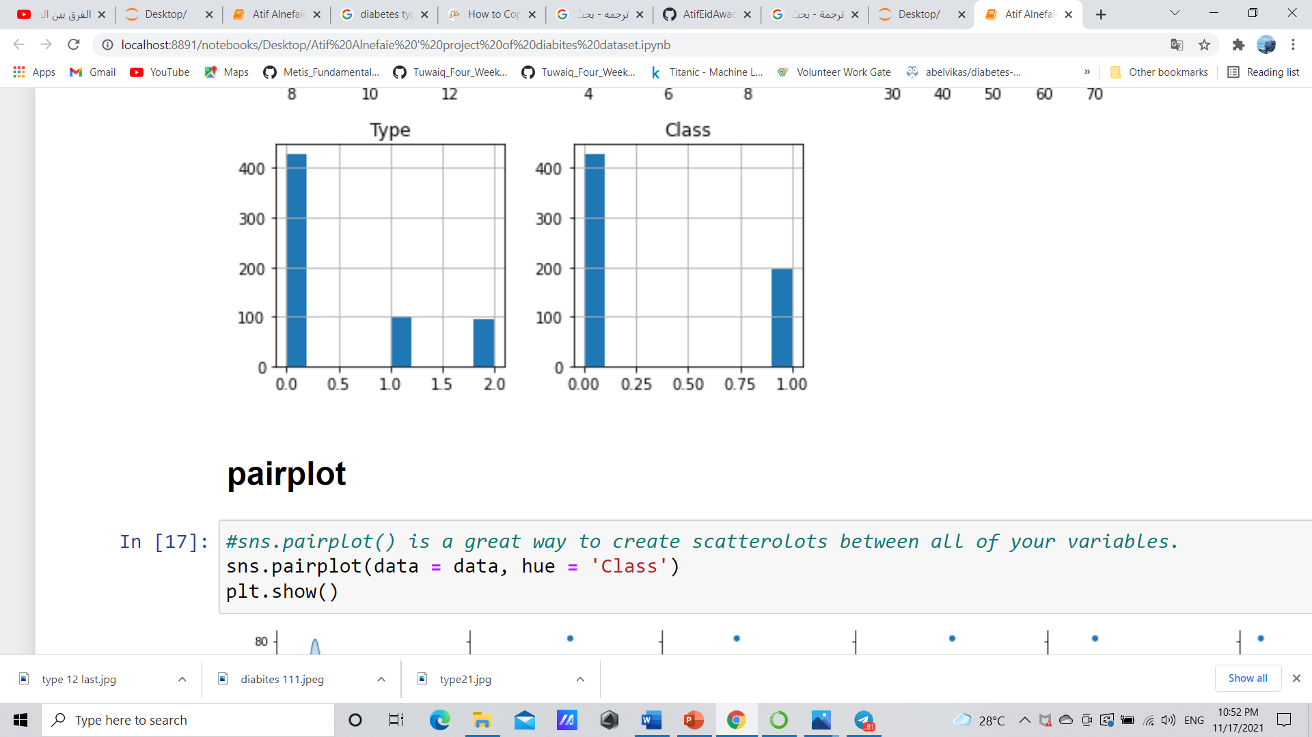
Helpful Visualizations
SADAIA TUWAIQ BOOTCAMP T5 4 WEEKS

Slide 5
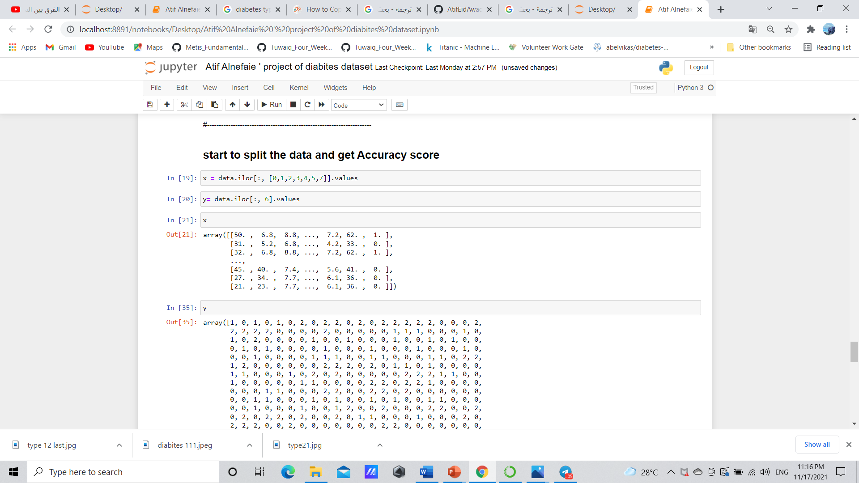
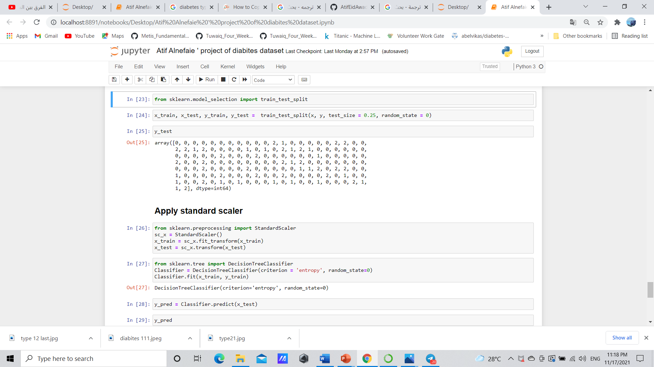
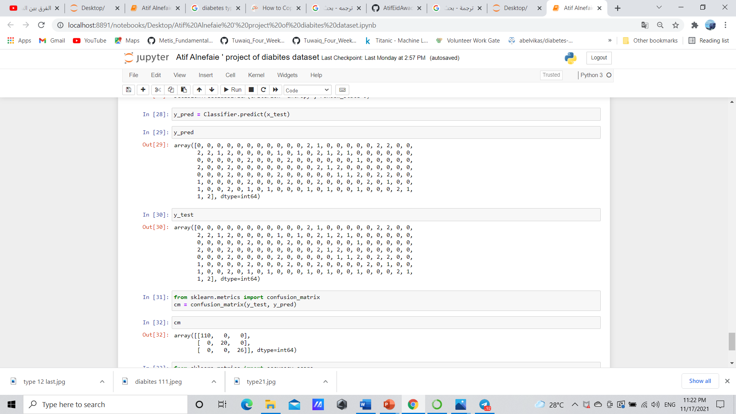
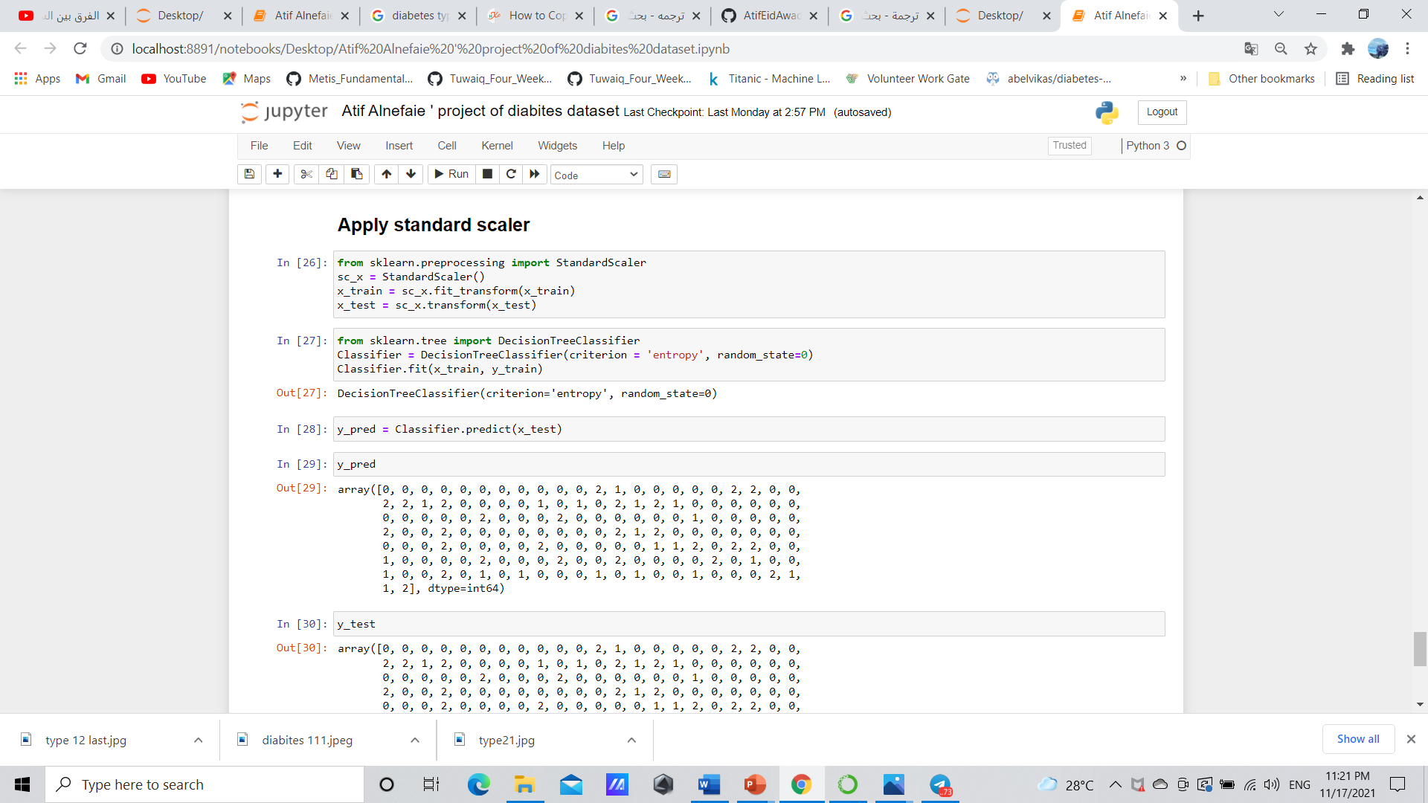
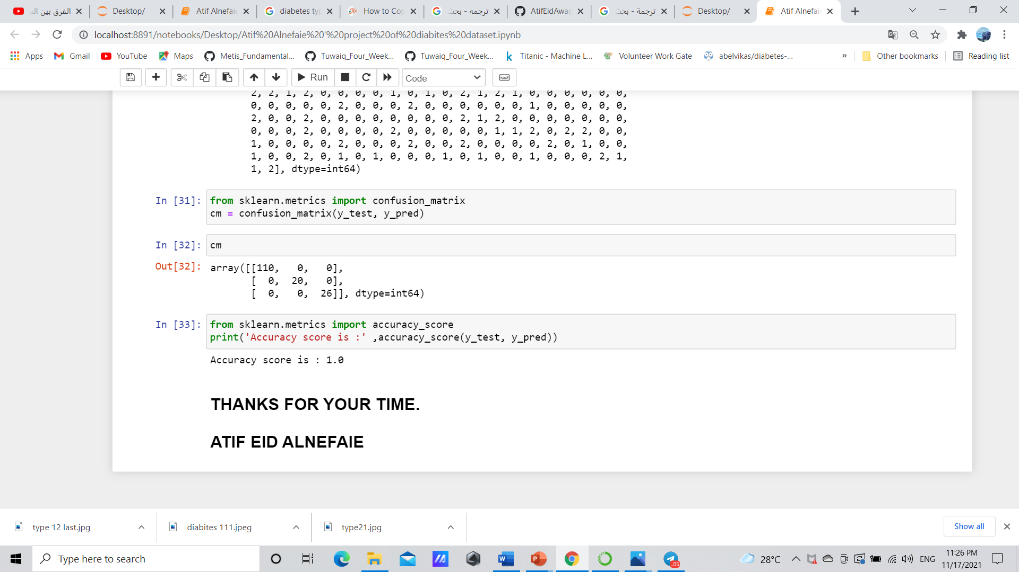
we tested the model's results using two methods
1- confusion matrix 2- accuracy_score and got a 100% perfect prediction.

Slide 6


MANAGING DIABETES
successfully requires:
self-discipline and a positive mindset
of the patient,
as well as understanding support
from loved ones
Prepare by: Atif Eid Alnefaie
Supervisor: Dr-Mariam – Dr-Shikh
Data scientist: Abdulrahman – Rasha
SADAIA TUWAIQ BOOTCAMP T5 4 WEEKS

